Slide 1

Cardiovascular Disease Risk Prediction Using Personal Lifestyle Factors
Portfolio Project 2
Nazish Abdullah.
Cohort 12

Slide 2
Introduction
The "Cardiovascular Diseases Risk Prediction Dataset," available on Kaggle, is a comprehensive resource designed to facilitate research and development in the field of cardiovascular risk assessment.
https://www.kaggle.com/datasets/alphiree/cardiovascular-diseases-risk-prediction-dataset.
This dataset encompasses a range of features relevant to cardiovascular health, including demographic, lifestyle, and medical history variables.
The Behavioral Risk Factor Surveillance System (BRFSS) is system of health-related telephone surveys that collect state data about U.S. residents regarding their health-related risk behaviors, chronic health conditions, and use of preventive services. From their dataset 19 variables have been picked for this analysis. The dataset has over 300,000 respondents input.
The dataset is clean from null and missing values. Only a small replacement has been made in the fields of Diabetes.

Slide 3
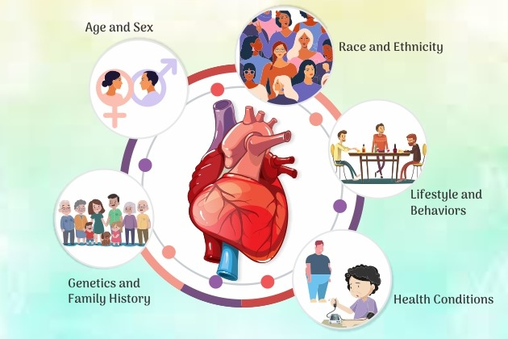
Objective
The objective of this report is to analyze medical history of patients having cardiovascular disease and finding controllable and uncontrollable predictive factors.
Secondly, in depth analysis of impact of lifestyle practices of respondents on occurrence of diseases listed in the dataset.
The dataset has medical record regarding 6 diseases and 6 lifestyle habits plus other physical factors.
One of the vital part of this study is to highlight factors which strongly impact the occurrence of CVDs, so that precautionary measures can be defined.

Slide 4
Dataset Variables
Medical History
Other Factors
General Health
Checkup
Heart Disease
Skin Cancer
Other Cancer
Depression
Diabetes
Arthritis
Gender
Age Category
Height_(cm)
Weight_(kg)
BMI
Exercise
Smoking History
Alcohol Intake
Fruit & Vegetables Consumption

Slide 5
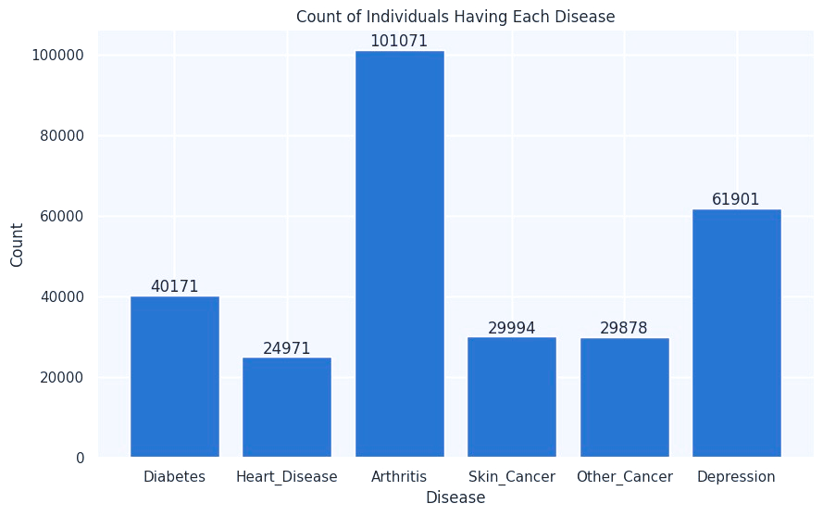
Identifying Stats for Different Diseases
The objective of this report is to analyze medical history of patients having cardiovascular disease and finding any relationship present between heart disease and other diseases.
For 308,800 respondents, the following graph shows number of respondents suffering from stated health problems.
Insights
As illustrated in graph, over 100,000 respondents are suffering from Arthritis, followed by depression and diabetes.
There are 24,971 respondents who have CVD.

Slide 6
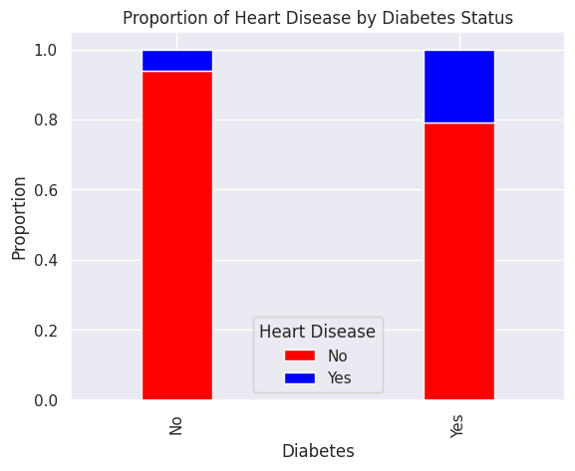
Relationship between Diabetes and CVD
In the given dataset, a positive relationship can be seen between occurrence of diabetes and cardiovascular disease.
Insights
Among 24,971 respondents having CVDs, majority also suffer from Diabetes .
Diabetes | Heart Disease
No | No | 94%
 | Yes | 6%
Yes | No | 78%
 | Yes | 22%

Slide 7
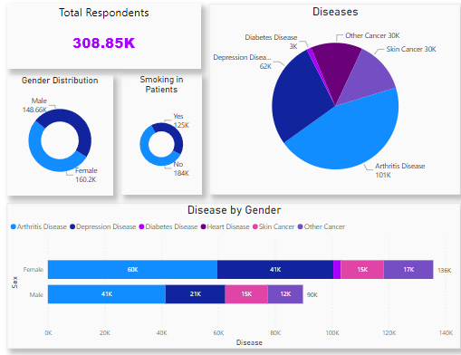
Insights
Female percentage is higher among Arthritis and Depression patients

Slide 8
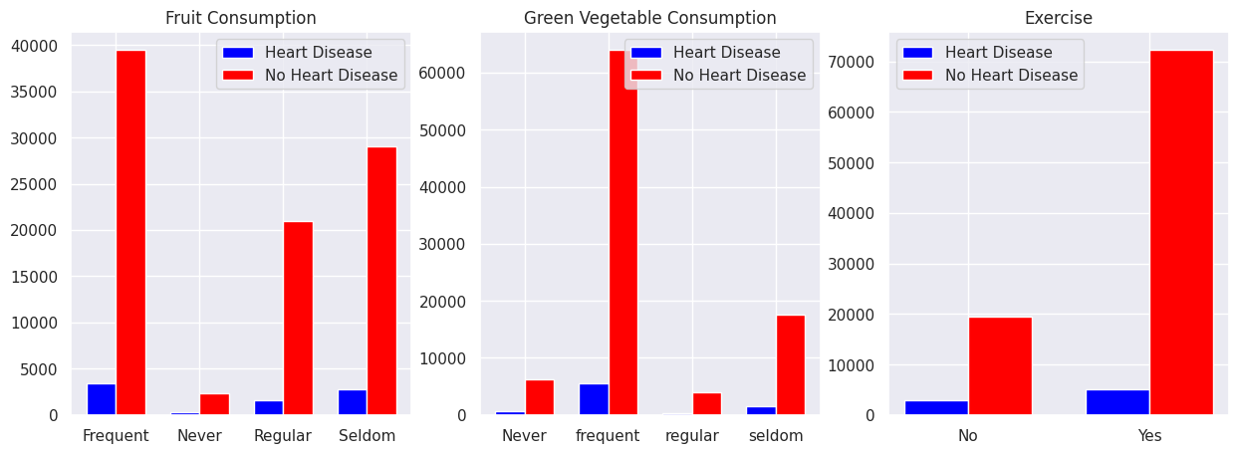
Identification of Controllable Factors
Insights
In the following illustrations we can see that among individuals who eat vegetables and fruits on regular basis very less percentage suffer from CVDs.
Regular exercise and physical activities are mandatory to main overall as well as health of the heart.

Slide 9
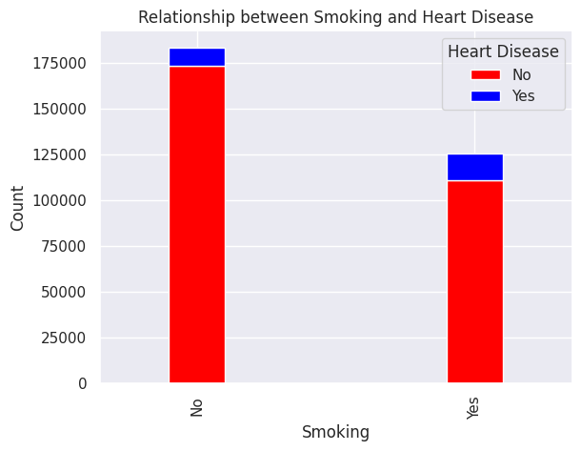
Identification of Controllable Factors
Smokers are at significantly higher risk for coronary heart disease, heart attacks, and other heart-related conditions.
We can see from the stats that the percentage of heart disease is double in individuals who have smoking history
Insights
Out of total respondents around 184,000 do not have smoking history.
Smoking | Heart Disease
No | No | 94%
 | Yes | 6%
Yes | No | 88%
 | Yes | 12%

Slide 10
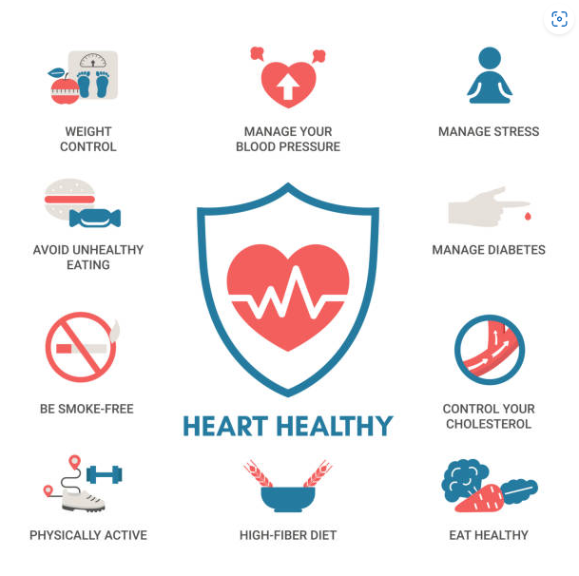
Preventing Cardiovascular Diseases: Key Recommendations
Eat a Heart-Healthy Diet
Emphasize fruits, vegetables, whole grains, and healthy fats
Maintain a Healthy Weight
Balance caloric intake with physical activity
Engage in Regular Exercise
Aim for 150 minutes of moderate activity per week
Include strength training twice a week
Avoid Smoking & Limit Alcohol
Quit smoking and reduce alcohol consumption
Control Cholesterol & Blood Sugar
Follow dietary guidelines and monitor levels
Get Regular Health Checkups
Regular exams and follow medical advice
Stay Socially & Mentally Active
Maintain social connections and manage stress

